Slide 1
Mental Model
Everybody sees the world with a pair of glasses.

Slide 2

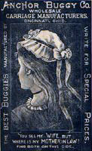
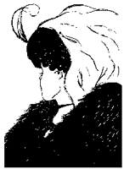
W.E. Hill’s My Young wife and Mother in Law

Slide 3
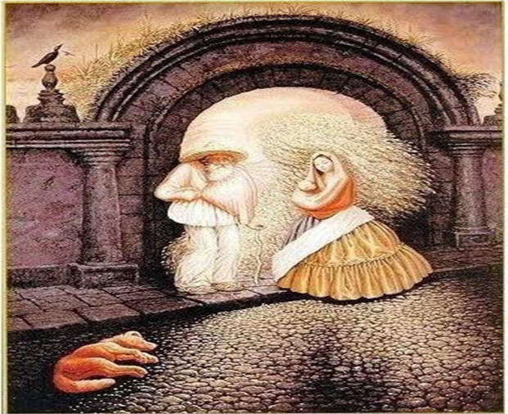

Slide 4
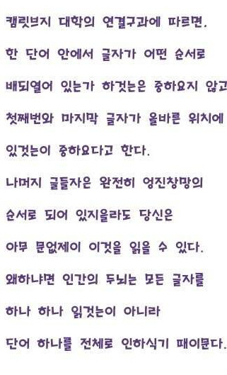
Construct order out of disorder

Slide 5
__ILK

Slide 6
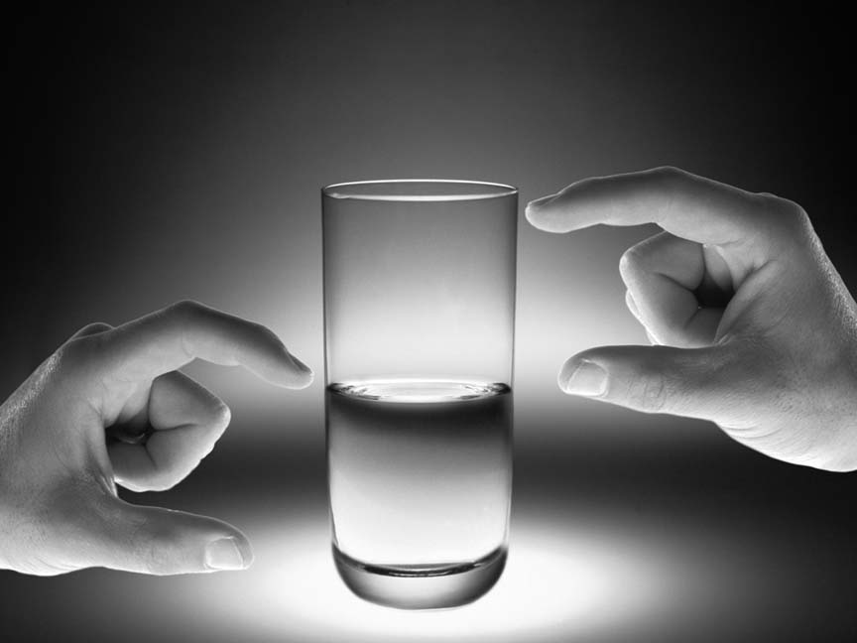
Frame the world differently

Slide 7
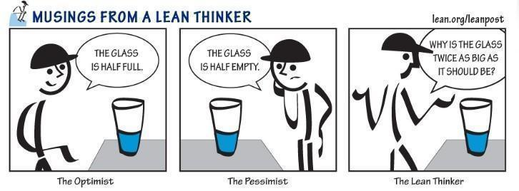

Slide 8
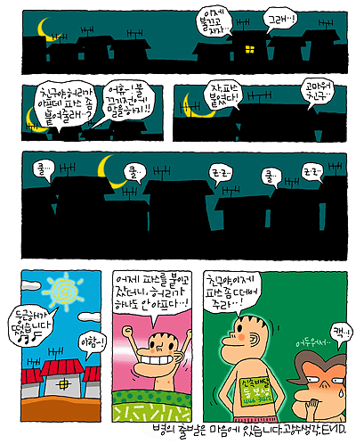
Change your body
역 량
광수생각

Slide 10
    How Does Mental Model Emerge?
Assumptions
Reconstruction
Of world based on
Big Assumption
MM
Test of
Assumptions
Beliefs
Big Assumptions

Slide 11

Definition of Mental Model
Humans’ cognitive map that works as a glass that helps interpret the outer world
and reconstruct the world as you believe.

Slide 12
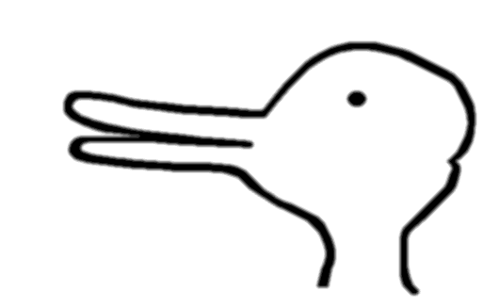

Slide 13


Slide 14
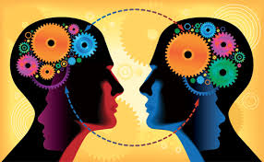

Slide 15
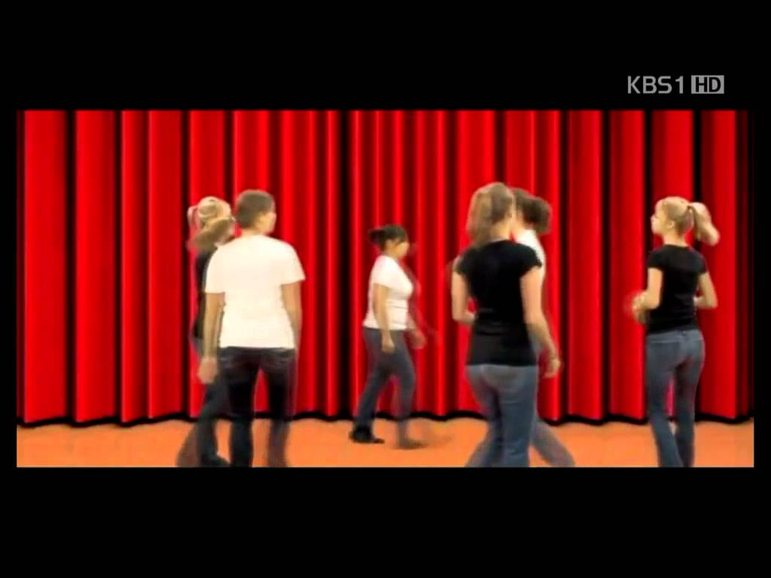
https://www.youtube.com/watch?v=0dTUQrdinSY

Slide 16
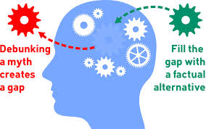
If you understand the principle of mental model, which statement is correct?
To see is to believe.
To believe is to see.

Slide 17
We see the world not through eyes but through mental models.
Build your attractive mental model to control your own destiny.

